Slide 1
Audio Classification
A Final Breakdown
By: Dean Cochran

Slide 2
Objective
The objective of this project is to build a general audio classifier capable of recognizing different sounds.
The classifier will be able to hear the noises, or ambience from an urban environments, and then hear a specific kind of sound, which the classifier will then be able to identify.

Slide 3
Purpose
Understanding - Many people can readily recognise particular sounds, but only after they’ve learned the characteristic of each sound over their lifetime.
Experience - I want to work with DSP (Digital Signal Processing) after college and this project serves as a way for me to be introduced into the field.

Slide 4
Big Picture
If this sounds like Shazam for Sounds, you’re thinking in the right direction. However, when thinking of Shazam, songs have no variation.
What allows music identification services to recognise tracks is that they can compare acoustic fingerprints.

Slide 5

Data
The Urban Sound 8K dataset
A collection of 8732 short clips covering 10 different sounds from urban environments

Slide 6

The Issues with the Data
The input format will be the digital waveforms, just as would be recorded by a microphone, stored as WAV files.
From this input, we’ll need to extract features.

Slide 7
Why we need deep learning
The challenge then, is to find measurable properties that differ in recordings and are alike.
The feature extraction makes this problem an applicable for deep learning, which is capable of automated feature learning.

Slide 8
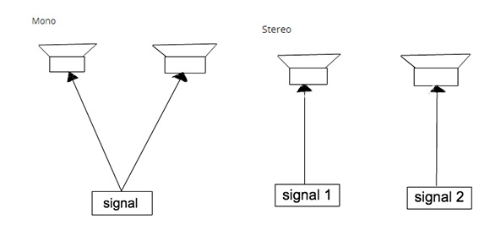
Data Exploration
Most of the samples are stereo recordings, sampled at 48000 hertz.
The librosa library converts the samples to a single (mono) channel, and down-samples each to 22050 hz

Slide 9
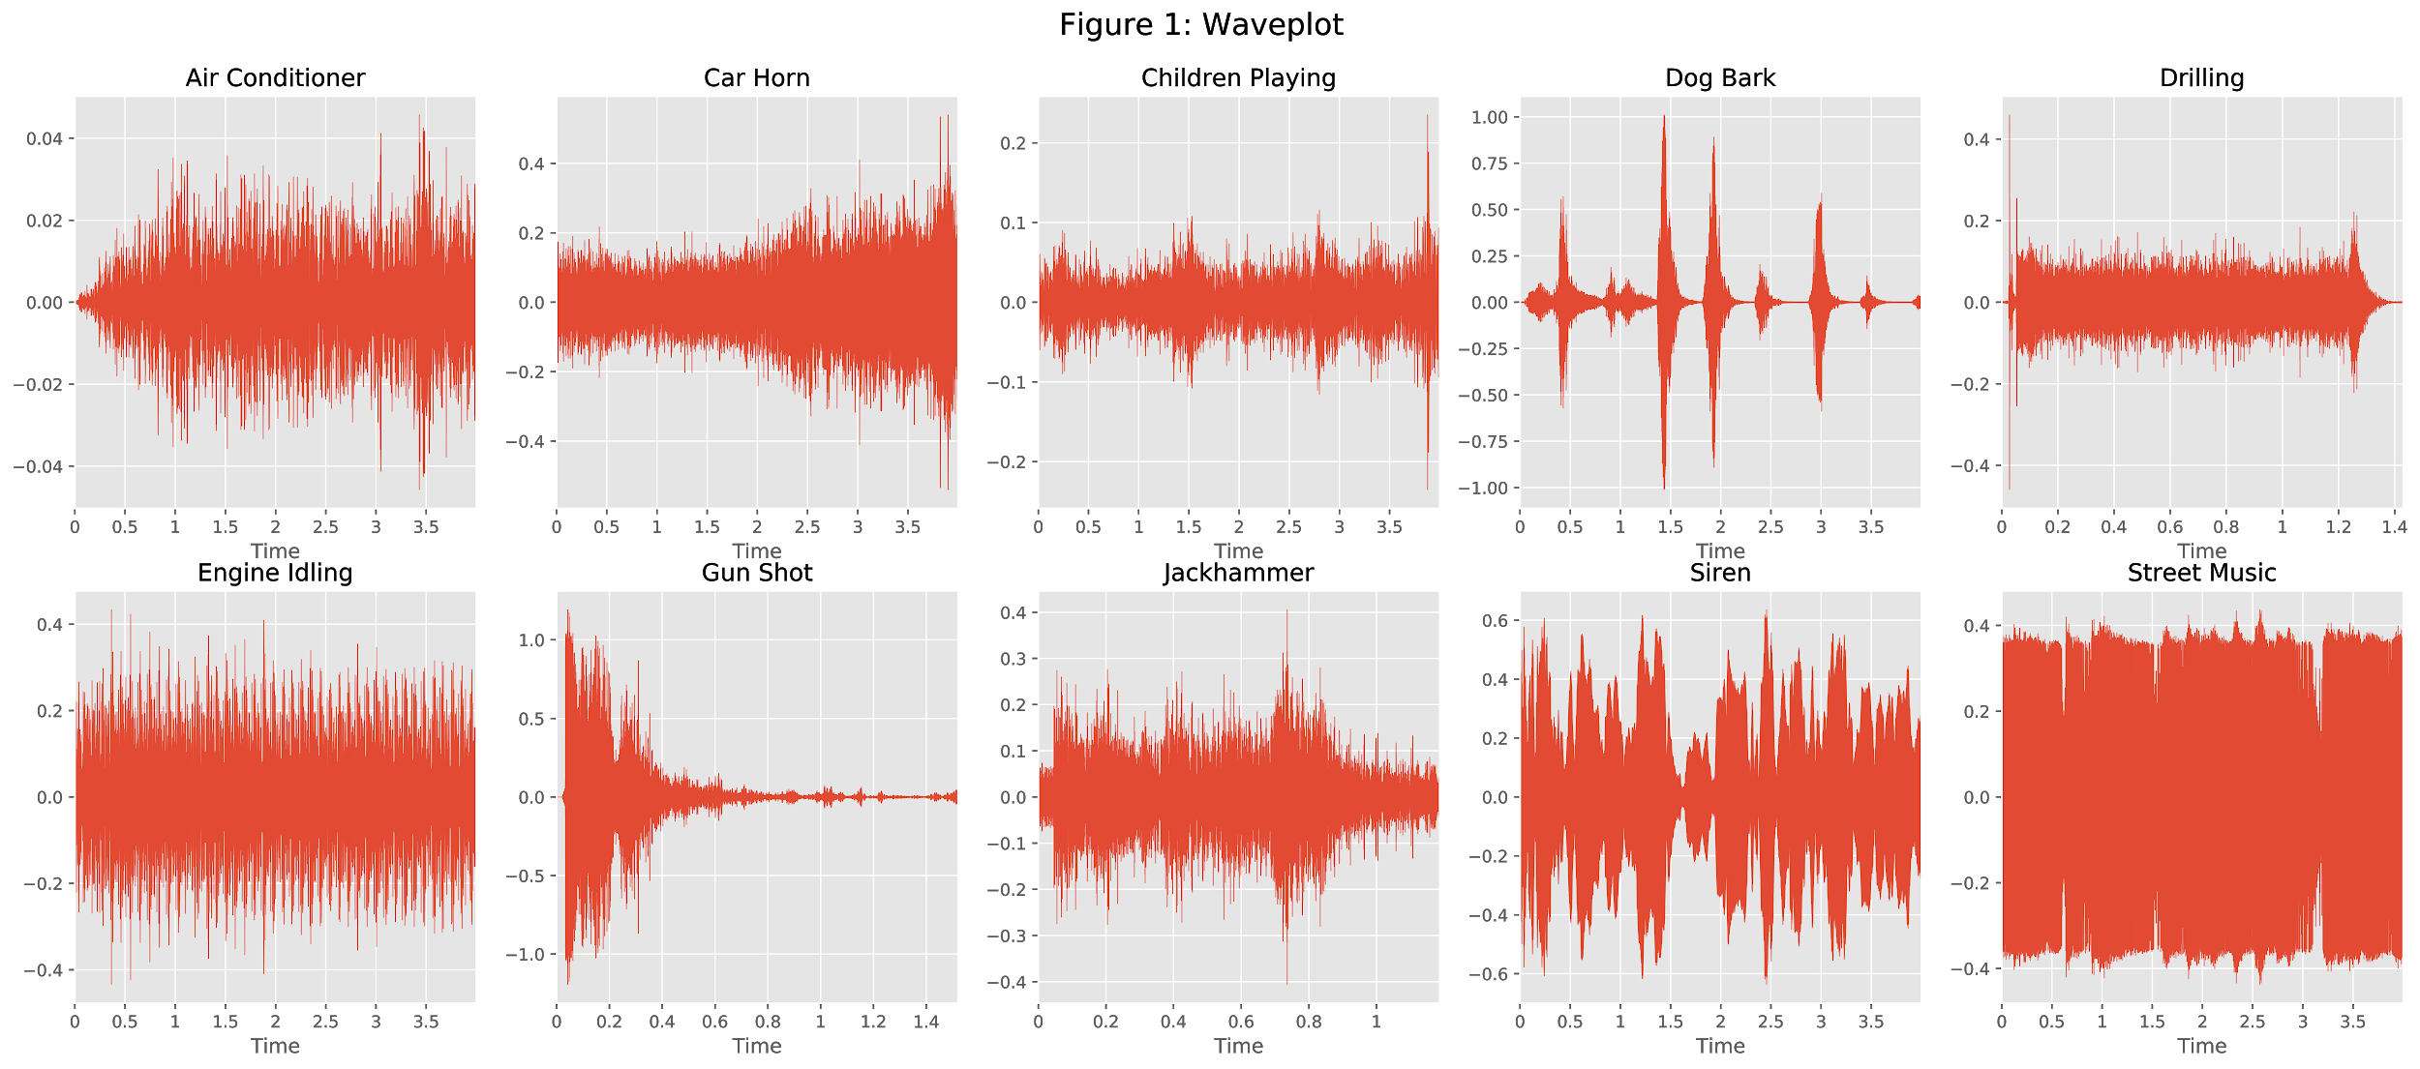

Slide 10
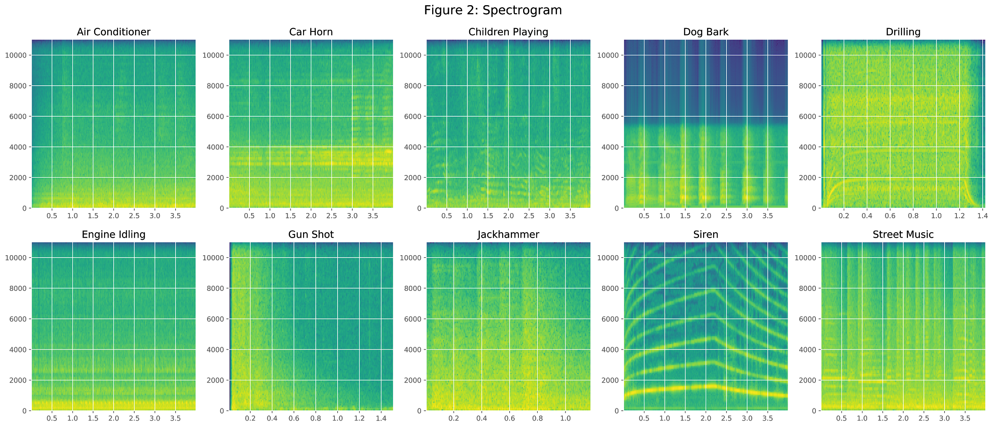

Slide 11
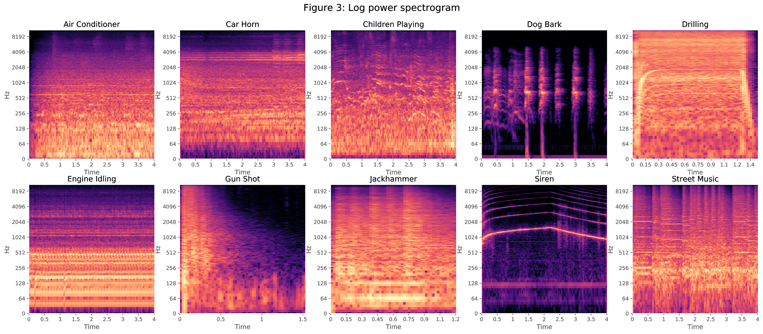

Slide 12
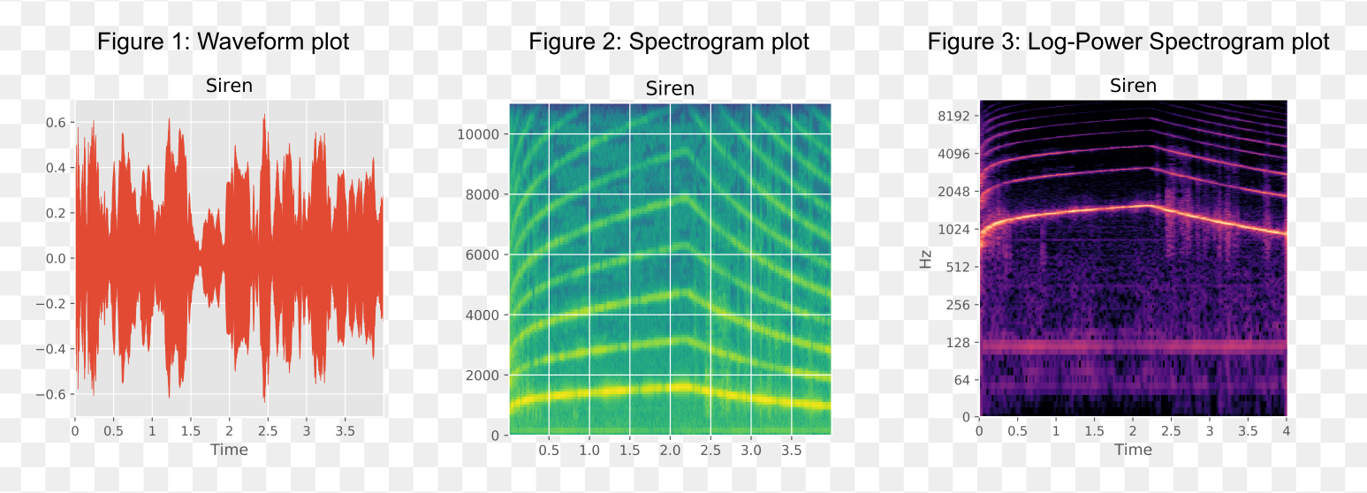
These plots illustrate the complexity of the data we need to process. In audio processing we can not determine what is sound and what is noise merely by looking at the quantiles of a frequency distribution.

Slide 13

Can you hear the difference
#1
Options to choose from:
Air conditioner
Car horn
Children playing
Dog bark
Drilling
Engine
Gunshot
Jackhammer
Siren
Music
#2
#3
#4
#5
#6

Slide 14
Can you hear the difference
Siren Sound
Options to choose from:
Air conditioner
Car horn
Children playing
Dog bark
Drilling
Engine
Gunshot
Jackhammer
Siren
Music
Engine Sound
Dog Bark Sound
Car Horn Sound
Air Conditioner Sound
Music Sound

Slide 15
Data Pre-Processing
Each second of audio consists of 22050 data values since it is sampled at a rate of 22050 hz.
The convention for neural networks is to have one input node per feature, which is far too many to run on a laptop.

Slide 16

All feature extraction methods are provided by the help of the Python librosa library.

Slide 17
Data Pre-Processing Methods
Mel-frequency cepstral coefficients
Mel-scaled power spectrogram
Chromagram of a short-time Fourier transform
Octave-based spectral contrast
Tonnetz

Slide 18
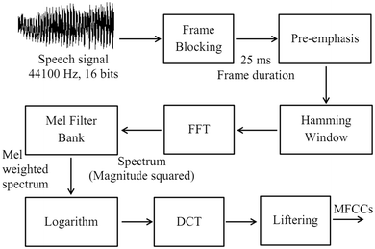
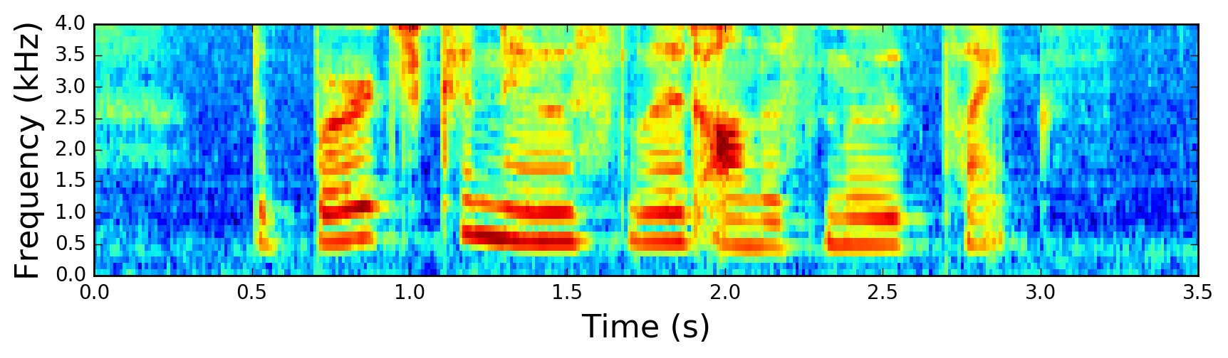
Mel-frequency cepstral coefficients
The coefficients that collectively make up the short-term power spectrum of a sound

Slide 19
Mel-scale power spectrogram
● The Mel Scale is used to provide greater resolution for more informative (lower) frequencies

Slide 20
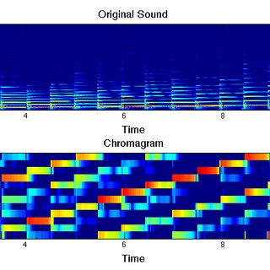
Chromagram of a Fourier Transform
Projects into bins representing the 12 distinct semitones (or chroma) of the musical octave

Slide 21
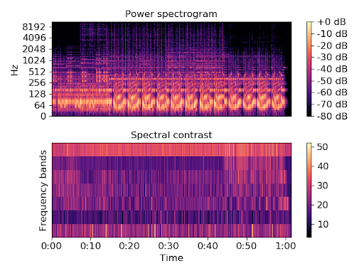
Octave-based spectral contrast
Distributions of sound energy over octave frequencies

Slide 22
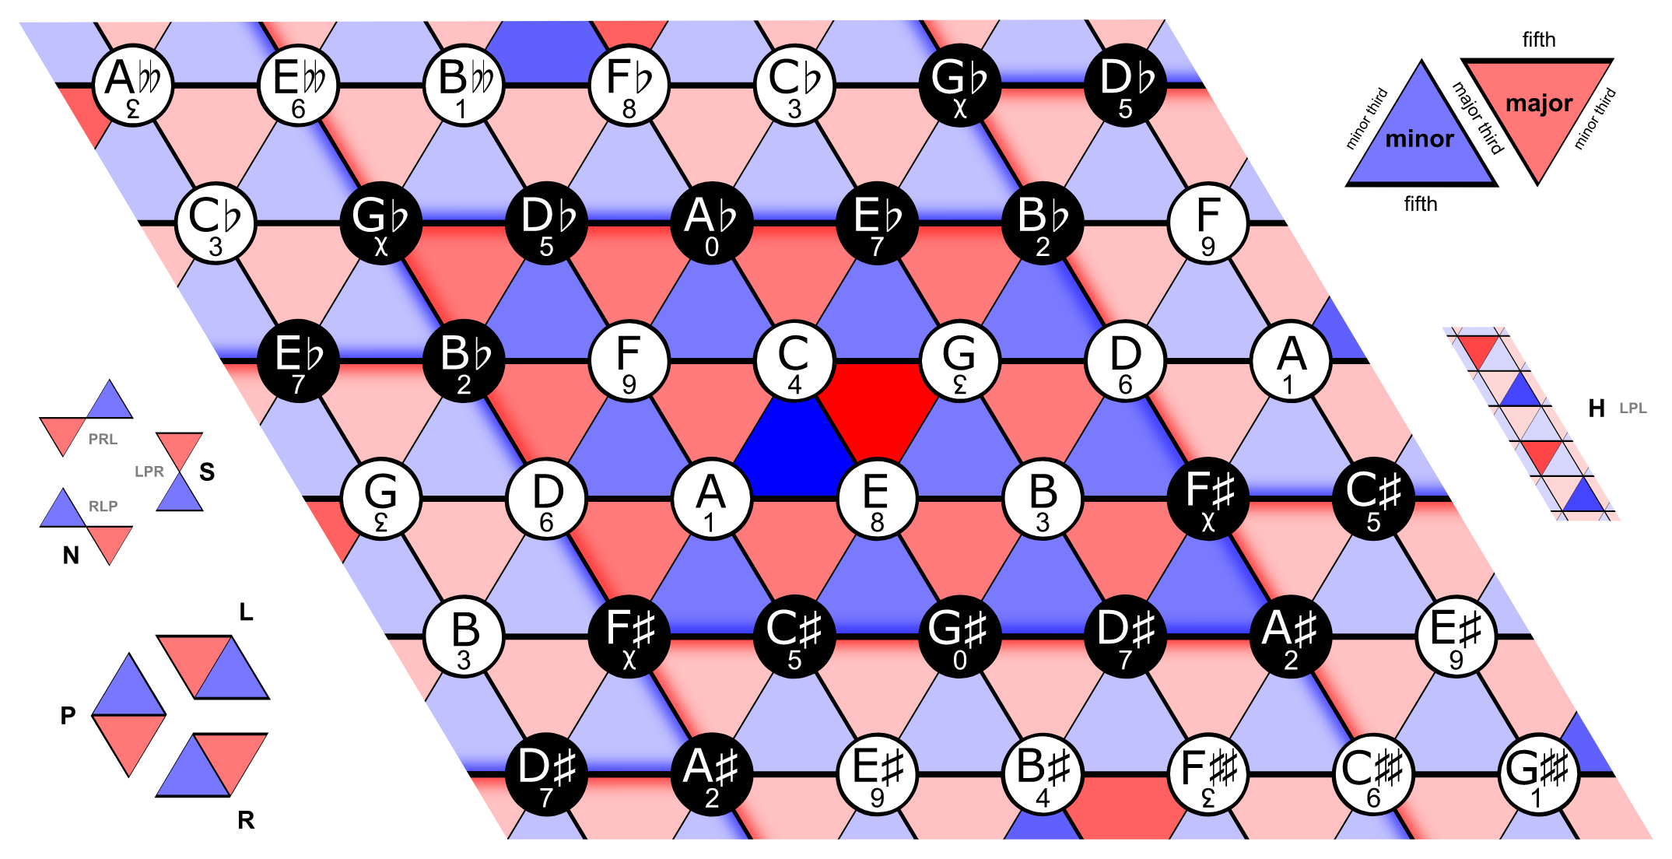
Tonnetz
First described by Leonhard Euler in 1739, Tonnetz is a conceptual lattice diagram representing tonal a six-dimensional interval space.

Slide 23
Data Pre-Processing
The results of these 5 extractions are concatenated to give a consistent feature vector of 193 values for every audio clip processed.
Numpy’s save feature to export the extracted features to files allows me to reload the data when I need it later.

Slide 24
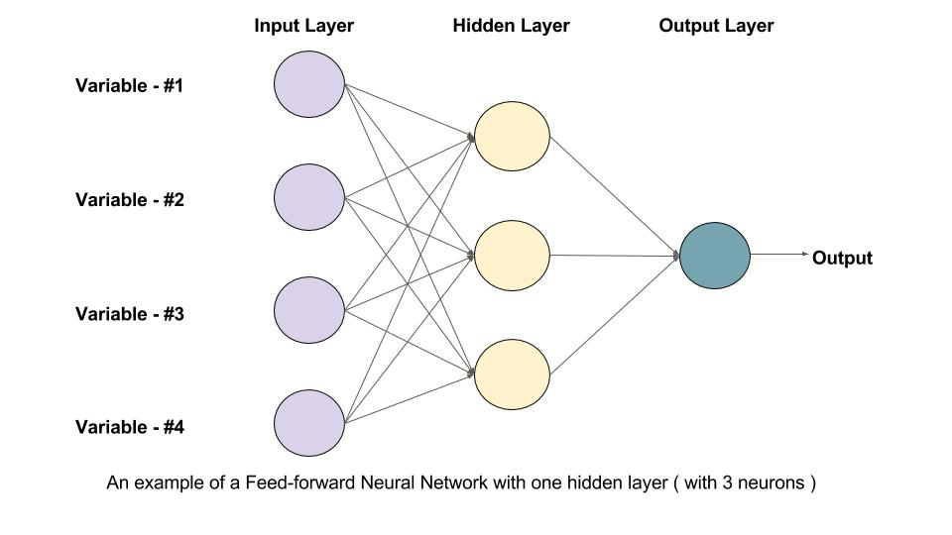
Model Building
Feed Forward Neural Networks feed information from the front input nodes to back output nodes, via several layers of hidden nodes.
For this project I intend to use Keras with a Tensorflow.

Slide 25
Model Building
The Keras Sequential Model, consisting of an input layer, and densely connected hidden layers.
As this was a multi-class classification problem, categorical_crossentropy a loss function was implemented.
So the model doesn’t generalize, a stopping function is added so that training can be stopped at the point when the model begins to overfit itself.
Notes:
categorical_crossentropy a loss function was implemented so the network can learn when its output is decisively wrong.

Slide 26
Model Building
A dropout policy between the final two hidden layers is added to promote the creation of complex connections between neurons of the hidden layers.
The choice of an optimiser was implemented as well since it is required for compiling a Keras model

Slide 27
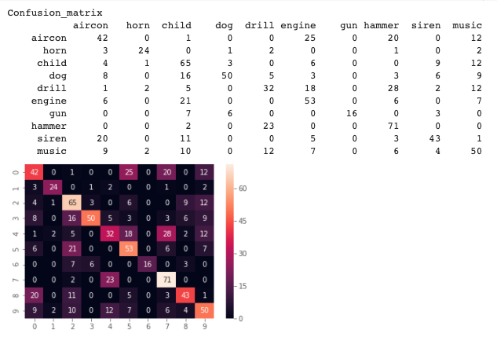

Slide 28
Model Tuning
Some of these parameters will have a greater influence than others, so utilizing Keras’s GridSearch Tool is our most useful option
Hyper-Parameters to be tuned:
Activation functions, Batch Size, Max Epochs, Initialisation functions, Dropout rate, and Optimiser algorithms

Slide 29
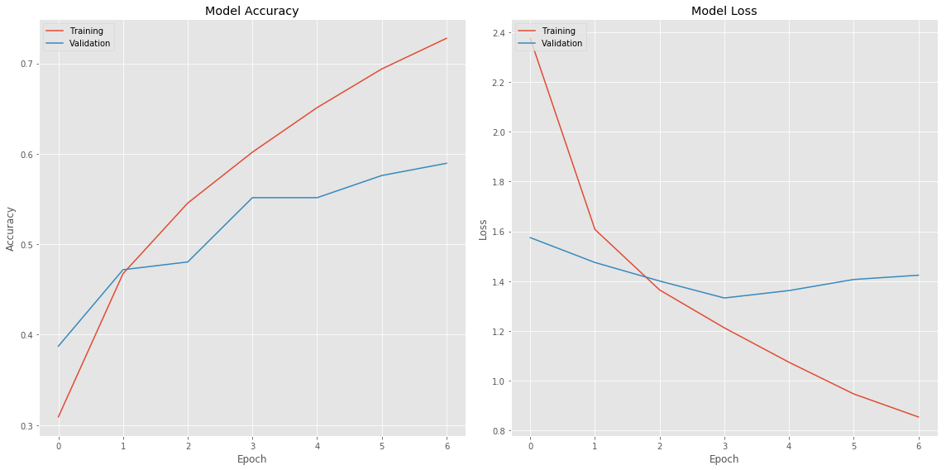

Slide 30
Results
Our resulting Highest F-Score: 0.53
In retrospect the resulting accuracy of our model could use some reworking.
However, given that my personal experience is limited in the industry of audio processing, this was a great success

Slide 31
Final Thoughts
As the feature extraction process relies on slicing the sound recordings into smaller, more manageable chunks.
If we needed to predict the class of a longer recording, we might need to employ some kind of ensemble learning and then use a voting process to determine which source is declared the best guess.

Slide 32
References
https://medium.com/better-programming/simple-audio-processing-in-python-with-pydub-c3a217dabf11
https://www.coursera.org/lecture/audio-signal-processing/python-and-sounds-p4oGc
https://www.pythonforengineers.com/audio-and-digital-signal-processingdsp-in-python/
https://github.com/librosa/librosa
https://pypi.org/project/librosa/
https://urbansounddataset.weebly.com/urbansound8k.html
http://www.justinsalamon.com/uploads/4/3/9/4/4394963/salamon_urbansound_acmmm14.pdf
https://medium.com/@hasithsura/audio-classification-d37a82d6715
J. Salamon, C. Jacoby and J. P. Bello, "A Dataset and Taxonomy for Urban Sound Research", 22nd ACM International Conference on Multimedia, Orlando USA, Nov. 2014.

Slide 33
ANY QUESTIONS?

